Slide 2

Hepatitis A
, B
, C
, D
, E
and More…

Slide 3

Professor
CL Lai
Professor of Medicine and Hepatology
Dept of Medicine, Queen Mary Hospital,
HKU

Slide 4
Introduction
Viral hepatitis A and E
Non-viral hepatitis
Viral hepatitis B and C (and D)

Slide 5


Slide 6

The Liver

Slide 7
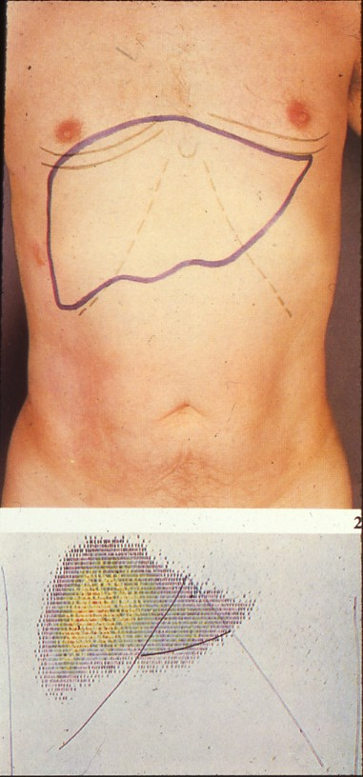

Slide 8
The Liver
The main functions of the liver:
Processing of absorbed nutrients to manufacture vital products, eg, proteins, vitamins, clotting factors, cholesterol
Removal of unwanted substances, eg, bacterial toxins
Secretion of bile, bile acids etc for digestion

Slide 9
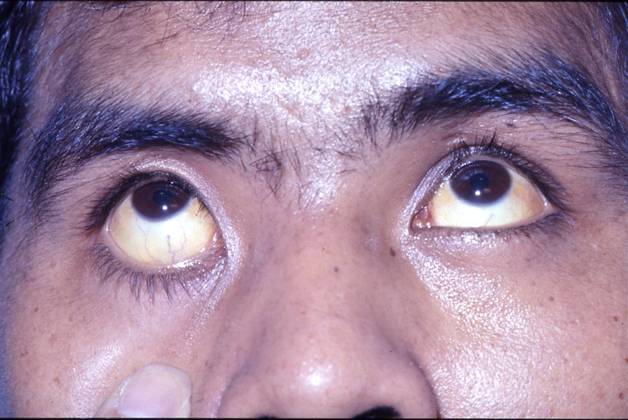
Jaundice

Slide 10
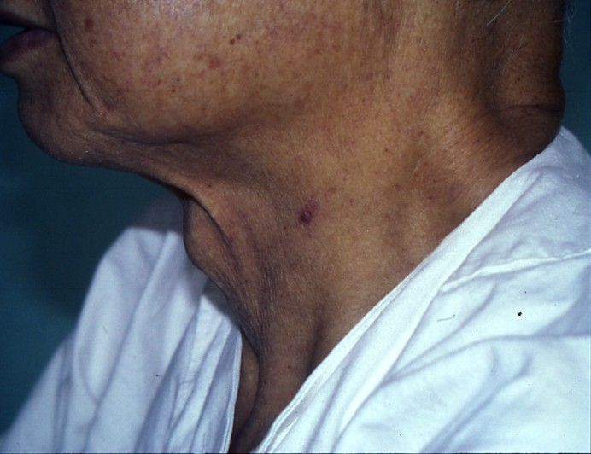
Spider Angioma

Slide 11
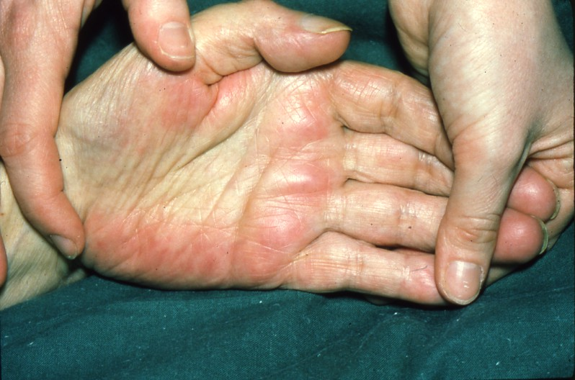
Liver palm

Slide 12
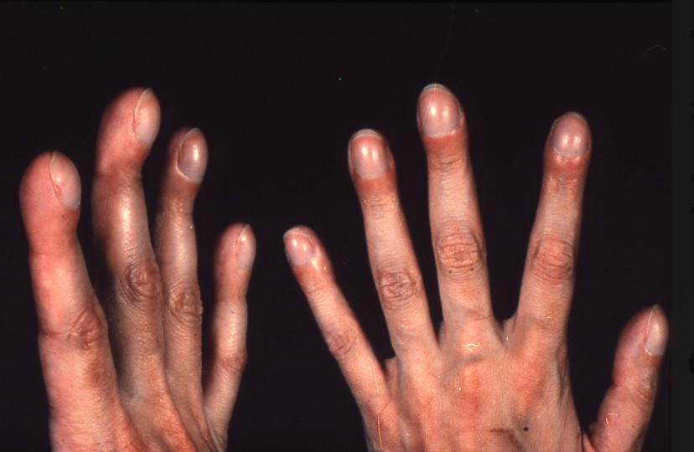
Clubbing of fingers

Slide 13

Hepatitis

Slide 14
Symptoms of Hepatitis
“hepa” = liver; “itis” = inflammation
Majority of hepatitis NO symptoms

Slide 15
Symptoms of Hepatitis
The older the subject, the more likely there will be symptoms:
- marked loss of appetite
- nausea
- mild fever
- right upper abdominal distension (NOT pain)
- darkening of urine colour
- jaundice

Slide 16

Viral Hepatitis A, B, C and E

Slide 17
Viral Hepatitis A, B, C and E
Which types of hepatitis virus cause chronic infection (慢性带菌/病毒)?

Slide 18

Viral Hepatitis A

Slide 19
Hepatitis A
Faecal Oral Transmission
• Virus shed into faeces during incubation
- Not well-cooked shellfish from infected water, especially clams
- Ingestion of infected water e.g. from uncooked vegetable
- Faecal contamination : children, sex, health care workers

Slide 20
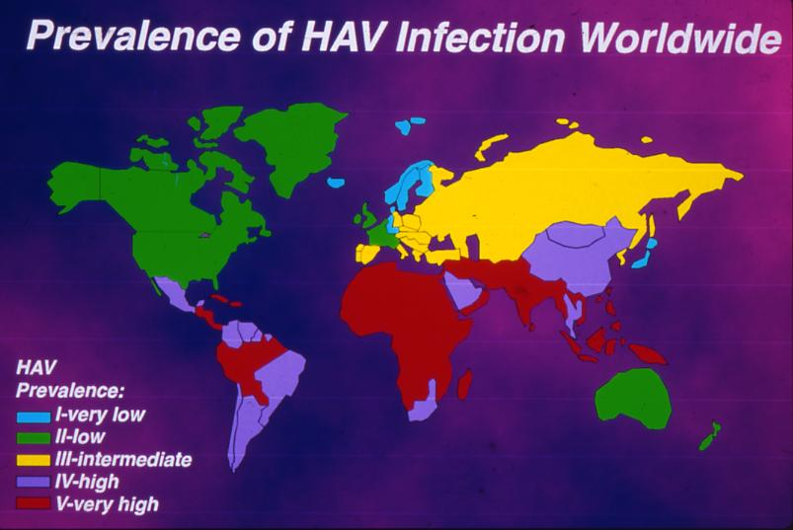
World Prevalence of Hepatitis A

Slide 21
Hepatitis A
Fatality
• Variation with age (CDC 1990)
- < 14 years 0.1%
- 15-39 years 0.4%
- > 40 years 1.1%

Slide 22
Hepatitis A
Decreasing incidence in HK over the last decade
% change of notifications in 2009 over preceding 5 years: -21.3%
Partly related to better health education; partly due to vaccination

Slide 23
Hepatitis A
Clinical course
• Self-limiting infection; NO carrier state
• Diarrhoea comparatively common in
early stage
• Recovery within 4-6 weeks

Slide 24
Hepatitis A Prevention
Careful cooking of shelled seafood
Virus killed by
- Dry heat at 100°C in 1 min
- Wet heat at 100°C in 5-10 mins
Not killed at 60°C even in 12 hrs
• Chlorination of drinking water

Slide 25
Hepatitis A Prevention
• Vaccine
· Inactivated whole virus from cell cultures
· 2 doses
· Effective protection within 3-4 weeks after the first dose
· Primary target adult travelers who have not been infected (HAV occurs 40 X more than typhoid, 800 X more than cholera)

Slide 26

Viral Hepatitis E

Slide 27
Hepatitis E
Increasing incidence in HK over the last 5 years
% change of notifications in 2009 over preceding 5 years: +39.8%
• Hence increasing incidence in HK, eg, in 2012, 43 cases of hep A vs 149 cases of hep E

Slide 28
Hepatitis E
Transmission: 2 Sources
• Waterborne similar to hepatitis A e.g. 4000 cases in 2004 with Sudan civil war through water contamination

Slide 29
What is the second source of infection for hepatitis E?

Slide 30
Hepatitis E
Transmission: 2 sources
• Waterborne similar to hepatitis A e.g. 4000 cases in 2004 with Sudan civil war through water contamination
• Zoonotic disease from animals, especially from swine, first described in Japan and USA.

Slide 31
Comparison with Hepatitis A
Similar clinical course with 2 differences:
High death rate in pregnant women (10-20%) due to “fulminant” course
Usually no carriers as with hepatitis A, except in patients with organ transplant

Slide 32
Prevention of Hepatitis E
Eat only well-cooked pig’s liver (and presumably pig’s blood)
Drink boiled water
One vaccine in China but not licensed elsewhere

Slide 33

Non-Viral Causes
of Hepatitis

Slide 34
Non-Viral Causes of Hepatitis
Alcohol
Drugs
Traditional Chinese medicine (TCM)
Some hereditary diseases

Slide 35
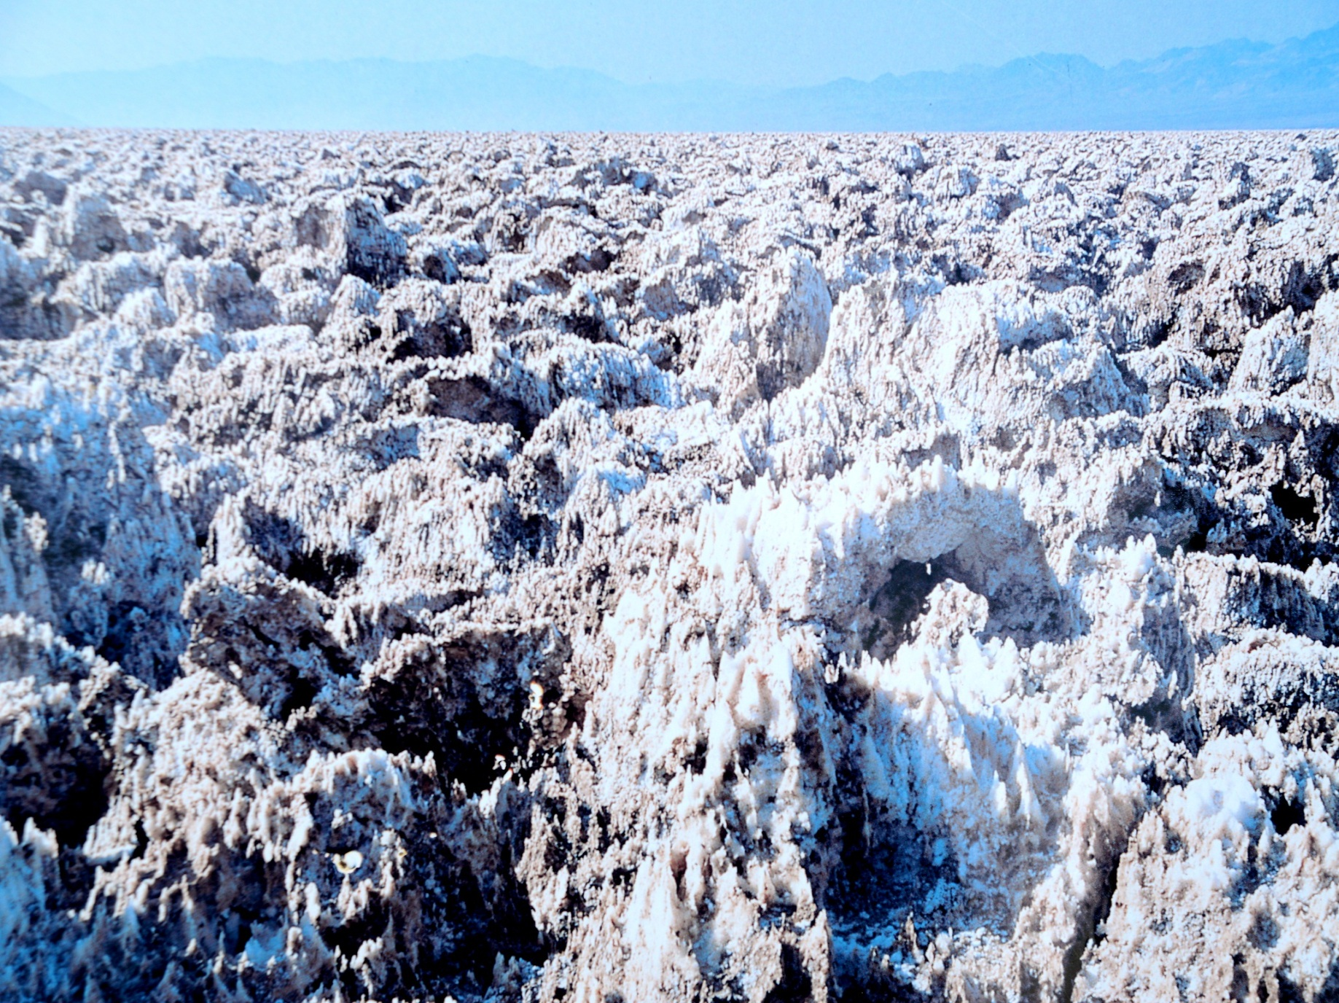
Viral Hepatitis With Chronic Carrier States

Slide 36
Chronic Viral Carriers
People who carry the virus for a long time/ for life
Chronic hepatitis B
Chronic hepatitis C
Chronic hepatitis D: This can only occur in carriers of the hepatitis B virus because the hepatitis D virus requires the coat of the hepatitis B virus to survive
(so-called “satellite virus)

Slide 37

Viral Hepatitis C

Slide 38
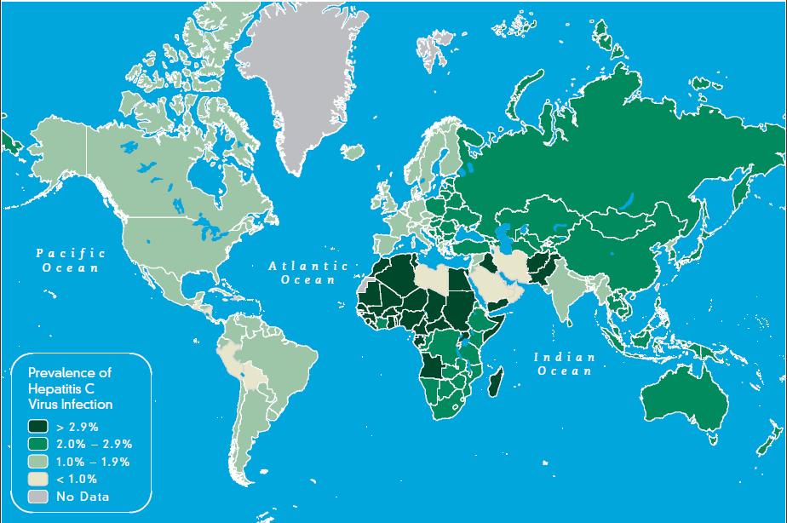
Centers for Disease Control and Prevention, USA
2012 Yellow Book online

Slide 39
Chronic Hepatitis C
WHO data:
- 2-3% of world population infected
- 170 milion people have chronic HCV
China:
- 1-1.9 % infected
- 13 million chronic HCV
Hong Kong:
- 0.5% infected
- 36,000 chronic HCV

Slide 40
Chronic Hepatitis C
Transmission:
Through infected blood
Blood transfusion of infected blood (30%). HK Red Cross started screening for HCV since 1 July 1991; the first component of HCV only discovered in 1989
Intravenous drug abuse (40%)
Other mode of needle sharing, eg, ear piercing, tattoo, acupuncture
Other routes are rare: mother to child, sex

Slide 41
Chronic Hepatitis C
Sequelae:
Liver cirrhosis (hardening of the liver with shrinkage)
Liver cancer

Slide 42

Hepatitis C:
Treatment and Prevention

Slide 43
Chronic Hepatitis C
Treatment:
Being RNA virus, can be cured
New oral drugs available since 2016
8 -12 weeks only, with cure rate of 95-100-%
The remaining problems:
Cost per treatment is HK $80,000-200,000!!
How to trace the HCV carriers?

Slide 44
Chronic Hepatitis C
Prevention:
Blood donation screening, done in most first world countries. HK Red Cross was among one of the first to do so.
Avoid needle sharing

Slide 45

Hepatitis B, acute and chronic

Slide 46
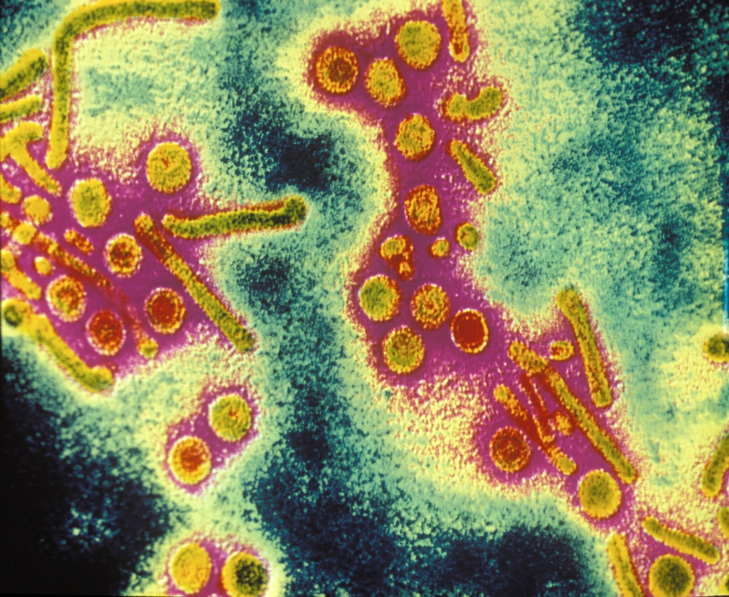

Slide 47
Transmission
Blood and body fluids
Infected mother to child at the moment of birth
Infected mother, AND father and other relatives, to child 1-2 years after birth

Slide 48
Transmission
Blood and body fluids
Needle sharing – intravenous drug users
Acupuncture, tattoo
Unsafe sexual contact
Sharing of other instruments, eg, tooth brush, razors
NO evidence that small amount of saliva is infectious

Slide 49
Acute vs Chronic Infection
Adult acquiring the infection, eg, through sex, chances of chronicity is ~1%
Children acquiring the infection, especially when under age 2, chronicity
>90%

Slide 50
50%
Carrier
mothers
14%
Carrier infants
Liver Death
50%
sons
Daughters

Slide 51
Sequelae of Chronic Hepatitis B
Males 50% die of cirrhosis of the liver or liver cancer
Females 14%
Hepatitis B virus can itself cause cancer, so-called oncogenic virus

Slide 52
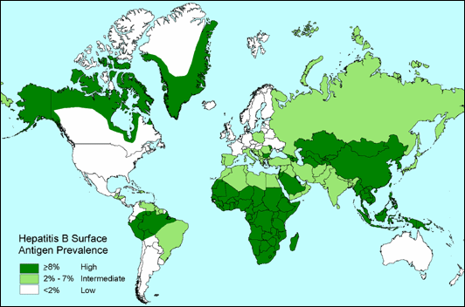
Prevalence of chronic hepatitis B

Slide 53

75% CHINESE
257 Million Chronic HBV Subjects

Slide 54

Treatment of Chronic Hepatitis B

Slide 55
Treatment of Chronic Hepatitis B
A new class of drugs called nucleoside analogues (核苷酸類似物)
Shown to decrease liver cancer and cirrhosis

Slide 56

Prevention of Hepatitis B

Slide 57
Prevention of Hepatitis B Infection
Avoid sharing instruments contaminated with bodily fluids
Use of disposable needles. In HK hospitals since mid-1980s
Safe sex

Slide 58
Hepatitis B Vaccine
One of the triumphs of medicine
1981- first use of vaccine using purified non-infectious particles from blood of infected persons
1986 – recombinant vaccine invented

Slide 59
What is meant by “recombinant” technology?

Slide 60
Hepatitis B Vaccine
One of the triumphs of medicine
1981- first use of vaccine using purified non-infectious particles from blood of infected persons
1986 – recombinant (基因重組) vaccine invented, by combining the gene of part of the hepatitis B virus to the bread yeast

Slide 61
Hepatitis B Vaccine
3 doses: at 0, 1 and 6 months
Babies from carrier mothers should receive an extra injection of immune antibody against the virus
Success rate in inducing antibody against the virus 95%
With production of antibody, protection against hepatitis B infection 100%
Immunity long lasting. NO need for booster dose

Slide 62
Hepatitis B Vaccine
Studies from Taiwan and Thailand show very definitively that the vaccine decreases liver cancer due to hepatitis B
HK Hospital Authority:
- 1984 vaccination of babies of carrier mothers
- 1998 universal vaccination of all newborn babies

Slide 63
Hepatitis B Vaccine
China gradual implementation of vaccination since 1992
>90 countirs in the world now have HBV vaccine programme for newborns

Slide 64

Summary

Slide 65
Summary
Hepatitis A:
- orally transmitted through contaminated shell fish
- vaccine available
Hepatitis E:
- orally transmitted through contaminated water and swine
vaccine only in China
No chronic carrier states

Slide 66
Summary
Hepatitis C:
- transmitted through blood
- chronic carriers state leading to cirrhosis and liver cancer
- treatment available but no vaccine

Slide 67
Summary
Hepatitis B
- transmitted through body fluids, mainly from mothers and fathers
- chronic carriers state leading to cirrhosis and liver cancer
- most important cause of liver disease in the Chinese
- treatment available
- vaccine since the 1980s

Slide 68

We shall not cease from exploration
And the end of all our exploring
Will be to arrive at where we started And know the place for the first time.
Little Gidding
TS Eliot

Slide 69


Slide 70

Thank You!!

